Slide 1
WELCOME
TO
MEDICAL STORE
MANAGEMENT SYSTEM
HENCIETA FEONA FERNANDES
1RR16CS058

Slide 2
ABOUT DBMS:
A Database Management System (DBMS) is a set of computer programs that controls the creation, maintenance and the use of a database.
It allows organization to place control of database development in the hands of Database Administrators (DBAs) and other specialists.
A Database is an organized collection of data.
A relational database is a collection of schemas, tables, queries, reports, views and other elements.
Existing DBMSs provide various functions that allow management of a database and its data which can be classified into four main functional groups:
1. Data definition: Creation, modification and removal of definitions that define the organizations of data.
2. Update: Insertion, modification and deletion of the actual data.
3. Retrieval: Providing information in a form directly usable or for further processing by other applications. The retrieved data may be made available in a form basically the same as it is stored in the database or in a new form obtained by altering or combining existing data from the database.
4.Administration: Registering and monitoring users, enforcing data security, monitoring performance, maintaining data integrity, dealing with concurrency control, and recovering information that has been corrupted by some event such as an unexpected system failure

Slide 3
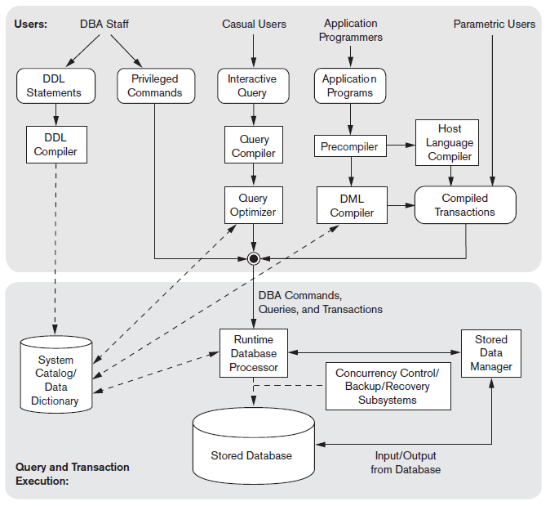
Fig. DBMS ARCHITECTURE

Slide 4
ABOUT ORACLE:
An Oracle database is a collection of data treated as a unit.
The purpose of a database is to store and retrieve related information.
A database server is the key to solving the problems of information management.
In general, a server reliably manages a large amount of data in a multiuser environment so that many users can concurrently access the same data.
A database server also prevents unauthorized access and provides efficient solutions for failure recovery.
Oracle Database is the first database designed for enterprise grid computing, the most flexible and cost effective way to manage information and applications.
There is no need for peak workloads, because capacity can be easily added or reallocated from the resource pools as needed.
The database has logical structures and physical structures. Because the physical and logical structures are separate, the physical storage of data can be managed without affecting the access to logical storage structures.
Oracle Database can be accessed from many programming languages and environments.
Java via JDBC, SQLJ
Microsoft .NET via ODP.NET
C and C++ via OCI, OCCI, Oracle's ODBC Driver, ODPI-C
Python via cx_Oracle
PHP via PHP OCI8, PDO_OCI
Java based languages like Scala can use JDBC to access Oracle Database.

Slide 5
Project Aim:
The main goal of the project on Medical Store Management System is to manage the details of Medical Shop, Medicines and its stocks and price, Supplier details. It manages all the information about Medical Shop, Sells, Products, Inventory. The project is totally built on the administrative end and thus only the Administrator is guaranteed the access. The purpose of the project is to build an application program to reduce the manual work for managing the Medical Shop, Medicines, Sells, and Stocks. It tracks all the details about the Suppliers, Medicines, Sales, and Stocks.
Project Scope:
It helps in collecting perfect management in details. In a very short time the collection will be obvious, simple and sensible. It helps in current all works relative to Medical Store Management System. The first subsystem is a Supplier which has all the details of all the suppliers of a particular Medical Shop. The second subsystem is Medicines. The third subsystem is Reports which generates reports to all suppliers and the pharmacists. My project aims at Business process automation, i.e. I have tried to computerize various process of Medical Store Management System.

Slide 6
EXISTING SYSTEM:
System Analysis is a detailed study of the various operations performed by a system and their relationships within and outside of the system. Here the question is- What all problems exist in the present system? What must be done to solve the problem? Analysis begins when a user or manager begins a study of the program using the existing system.
During Analysis, data collected on the various files, decision points and transactions handled by the present system. The commonly used tools in the system are Data Flow Diagram, interviews etc. The success of the system depends largely on how clearly the system is defined, thoroughly investigated and properly carried out through the choice of solution. A good analysis model should provide not only the mechanisms of problem understanding but also the framework of the solution. Thus it should be studied thoroughly by collecting data about the system.
In the existing systems all the jobs of the Medical Store Management is done manually. This is very difficult to be maintained with hands the process of keeping, maintaining and retrieving the information was very tedious and lengthy. If any information was to be found it was required to go through the different registers, documents there would never exist anything like report generation. In the current system it was very difficult to find errors while entering the records. Once the records were entered, it was very difficult to update these records. Moreover there would always be an unnecessary consumption of time while entering records and retrieving records.

Slide 7
PROPOSED SYSTEM:
The aim of proposed system is to develop a system of improved facilities. The proposed system can overcome all the limitations of the existing system. The system provides proper security and reduces the manual work. The existing system has several disadvantages and many more difficulties to work well. The proposed system tries to eliminate or reduce these difficulties up to some extent. The proposed system will help the user to reduce the workload and mental conflict. The proposed system helps the user to work user friendly and he can easily do his jobs without time lagging.
Advantages of Proposed System
The system is very simple in design and to implement. The system requires very low system resources and the system will work in almost all configurations. It has got following features
Ensure data accuracy’s.
Proper control of the higher officials.
Reduce the damages of the machines.
Minimize manual data entry.
Minimum time needed for the various processing.
Greater efficiency.
Better service.
User friendliness and interactive.
Minimum time required.

Slide 8
PROBLEM DEFINATION:
Medical store management system that was suggested till now, are not up to the desired level. There is no single system which automates all the process.
In order to build the system, all the processes in the business should be studied, System study helps us under the problem and needs of application. System study aims at establishing the requests for the system to be acquired, development and installed. It involves studying and analyzing the ways of an organization currently processing the data to produce information. Analyzing the problem thoroughly forms the vital part of the system study. In system analysis, prevailing situation of problem carefully examined by breaking them into sub problems. Problematic areas are identified and information is collected. Data gathering is essential to any analysis of requests. It is necessary that this analysis familiarizes the designer with objectives, activities and function of the organization in which the system is to be implemented.

Slide 9
SYSTEM REQUIREMENTS:
The following are the basic requirements for the project is given below
Hardware Requirements:
Pentium or higher processor.
1GB or more RAM.
Monitor 15’’ and above
Keyboard
Mouse
Software Requirements:
Platform used: Windows XP/7/8/10
Tools Used:
1. At front end: JDK 1. 8.0._111
2. IDE Tool: Eclipse IDE/Net Beans IDE 8.2
3. At back end: Oracle 10g xe
Language Used: java

Slide 10
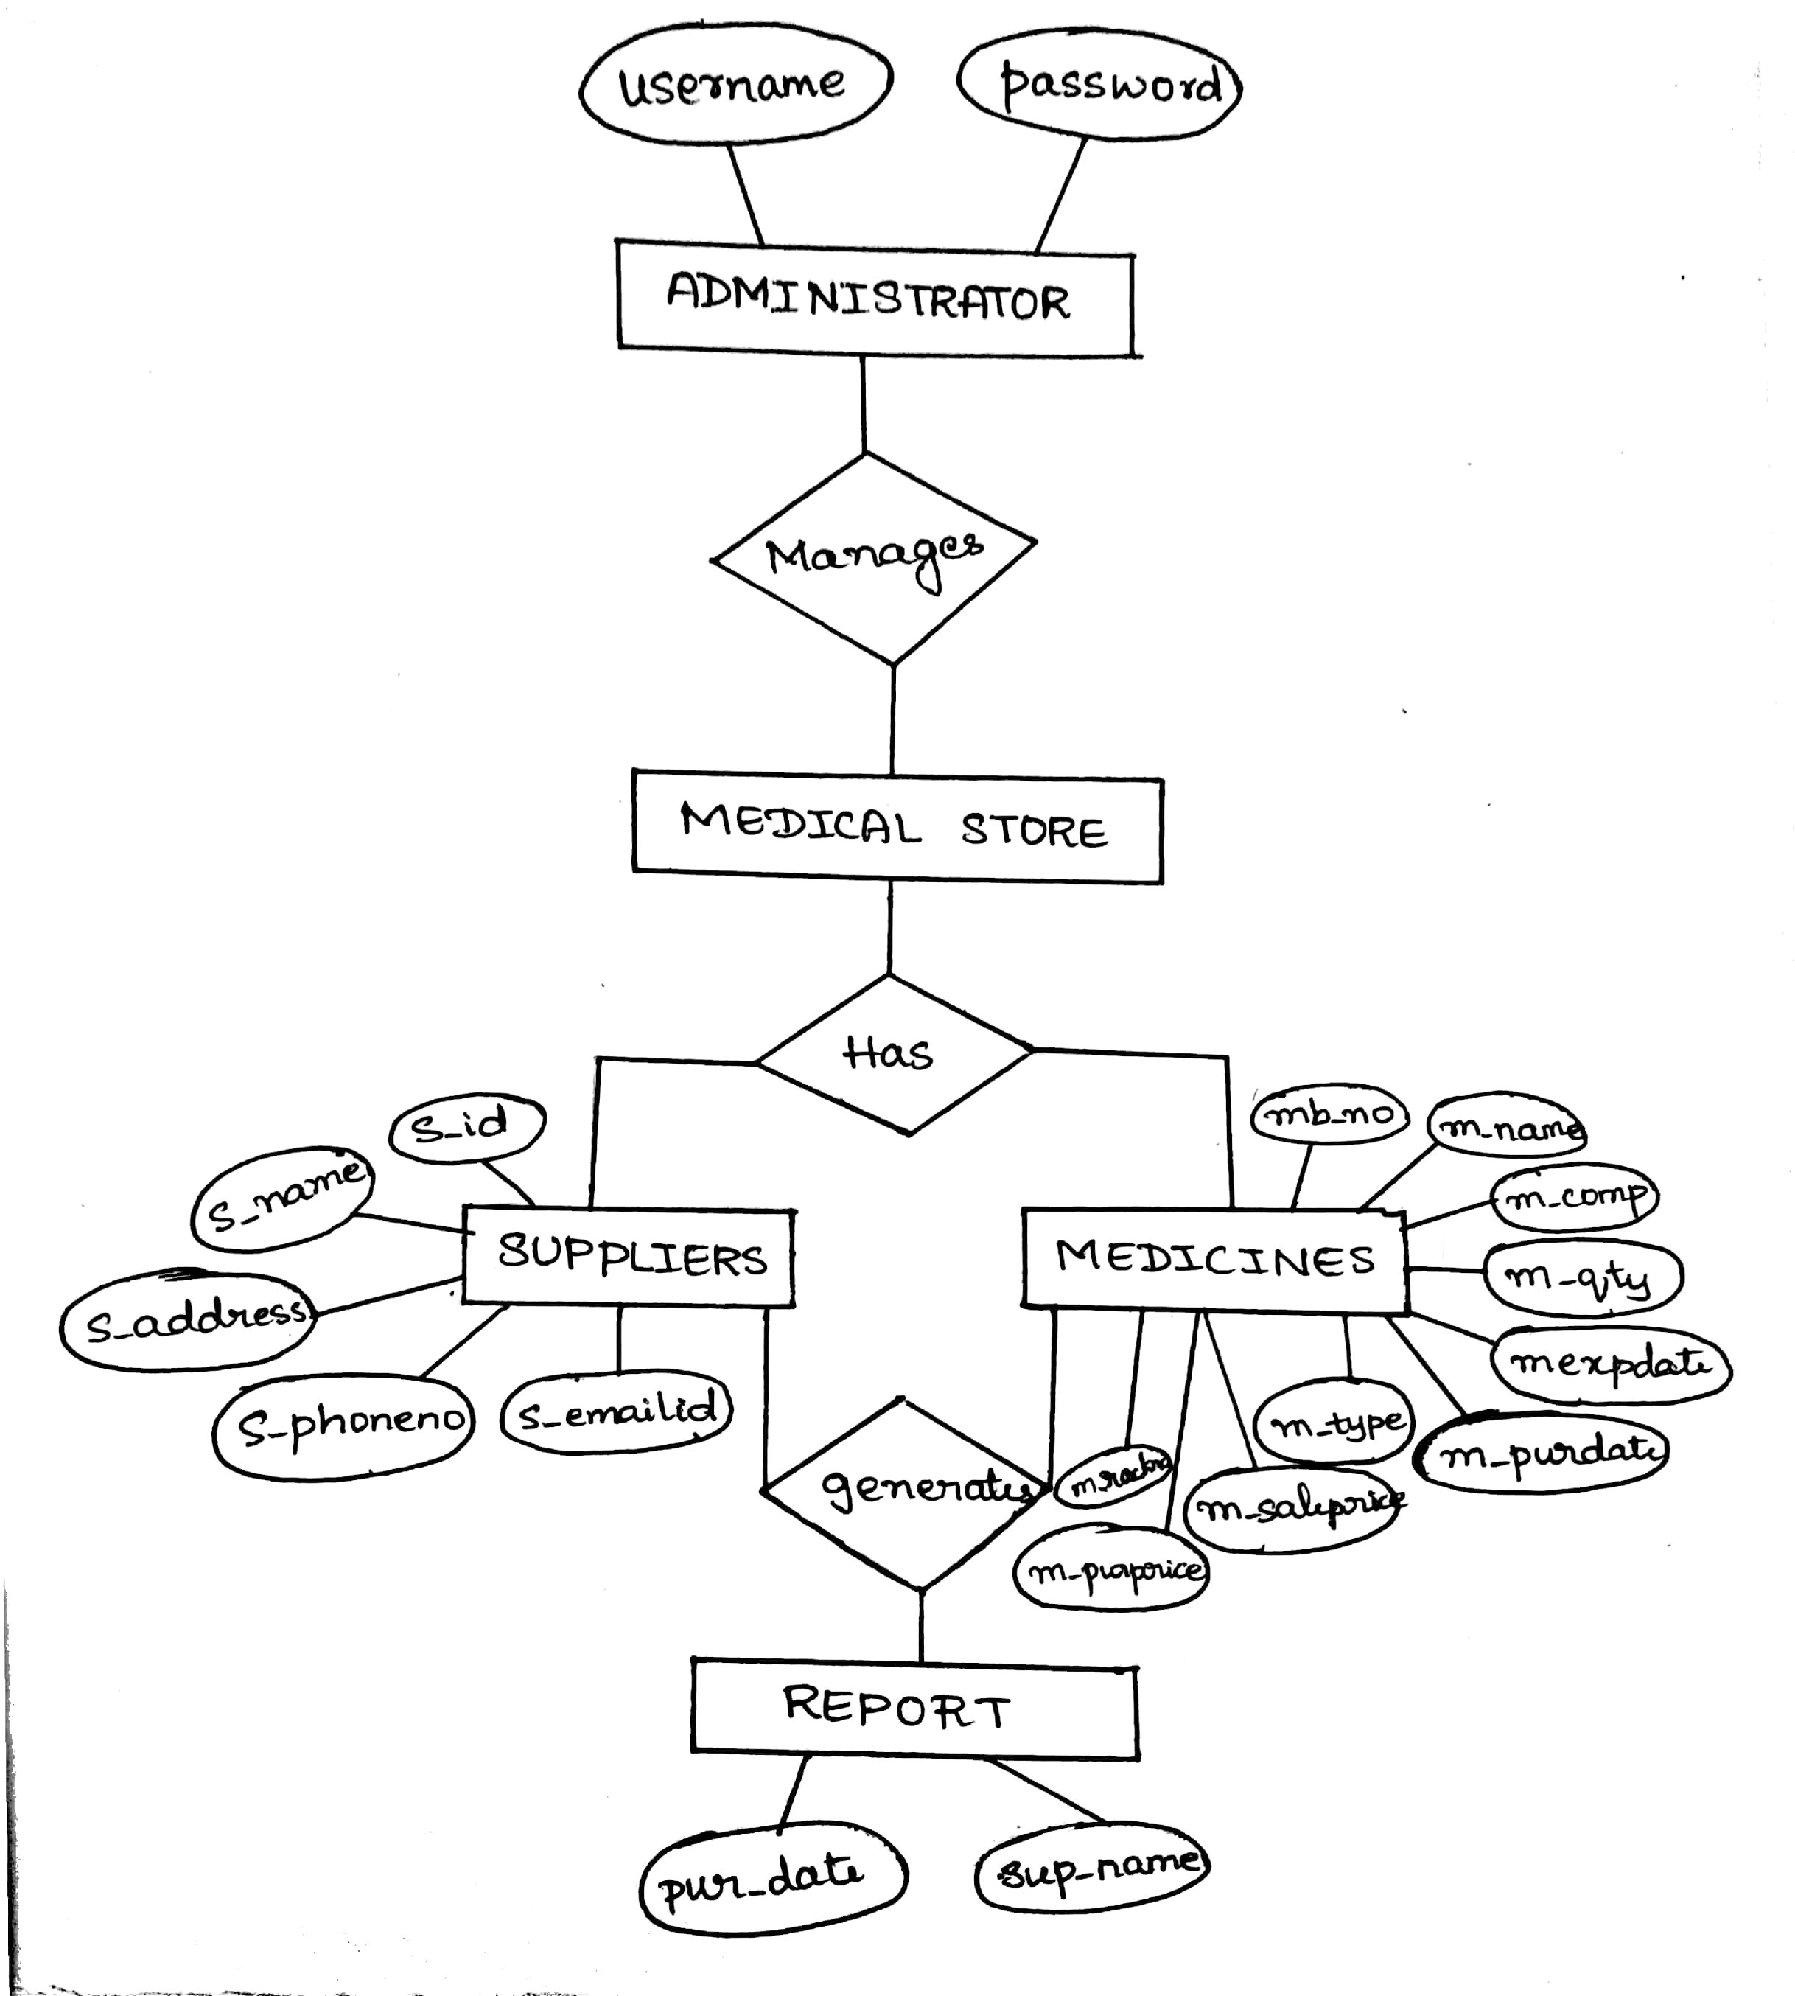
E-R DIAGRAM:
An entity-relationship model(ER model) describes inter-related things of interest in a specific domain of knowledge. An ER model is composed of entity types (which classify the things of interest) and specifies relationships that can exist between instances of those entity types.

Slide 11
SCHEMA DIAGRAM:
The descriptive detail of the database, which can be depicted by means of schema diagram. In this project the schema diagram consists of several entities like
ADMINISTRATOR
User Name | Password
SUPPLIER
s_id | s_name | s_address | s_phoneno | s_emailid
MEDICINE
mb_no | m_name | m_qty | m_comp | m_exp date | m_pur date | m_type | m_sale price | m_pur price | m_rackno
REPORT
pur_date | sup_name

Slide 12
IMPLEMENTATION
This project implementation is done by java language which consists of several classes as mentioned below to perform several operations.
CLASSES:
Login
{
Allows the administrator to login to the Medical Store Management System software with valid user id and password
}
Main Menu
{
Allows the administrator to add a new supplier and medicine, update or search or delete the suppliers, view suppliers list, to view the stock of medicines, view supplier wise medicine report, to view the daily purchase report.
}
Add New Supplier
{
Allows the administrator to add new supplier
}

Slide 13
Add New Medicines
{
Allows the administrator to add the new medicines
}
Search Supplier
{
Allows the administrator to search the suppliers with the supplier id or supplier name
}
Search Medicine
{
Allows the administrator to search the medicines with the Medicine batch number or Medicine name
}
Delete Supplier
{
Allows the administrator to delete the record of the existing supplier
}
Delete Medicine
{
Allows the administrator to delete the record of the existing medicines
}

Slide 14
Update Supplier
{
Allows the administrator to update the record of the existing suppliers
}
Update Medicines
{
Allows the administrator to update the record of the existing medicines
}
Supplier List
{
Allows the administrator to view the records of the existing suppliers
}
Medicine List
{
Allows the administrator to view the records of the medicines
}
Supplier Wise Medicine List
{
Allows the administrator to view the records of the Medicines by entering the Supplier name
}

Slide 15
Daily Purchase Report
{
Allows the administrator to view the records of the medicines by entering the Medicine Purchase Date
}
About
{
Allows the administrator to view the details of Medical Store Management System
}

Slide 16
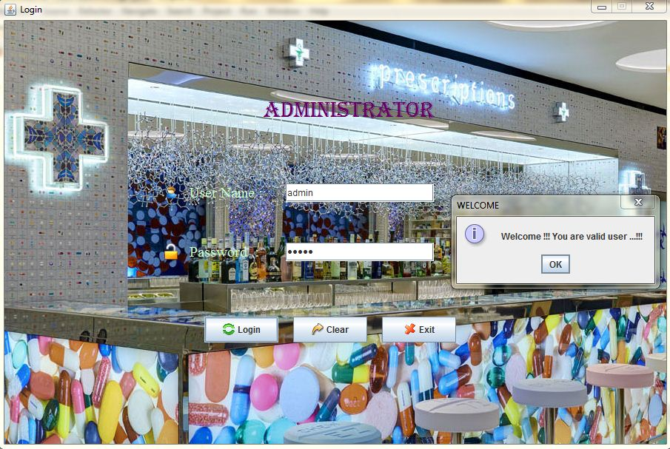
SCREENSHOTS
1. ADMIN LOGIN PAGE

Slide 17
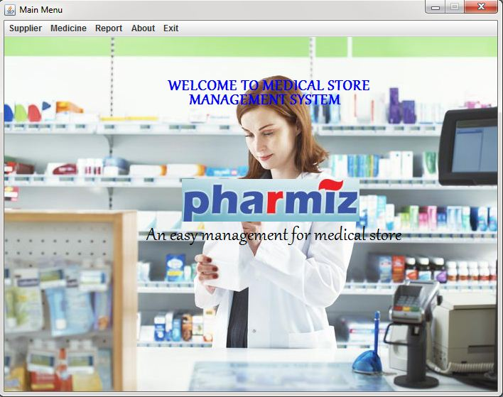
2. MAIN MENU

Slide 18
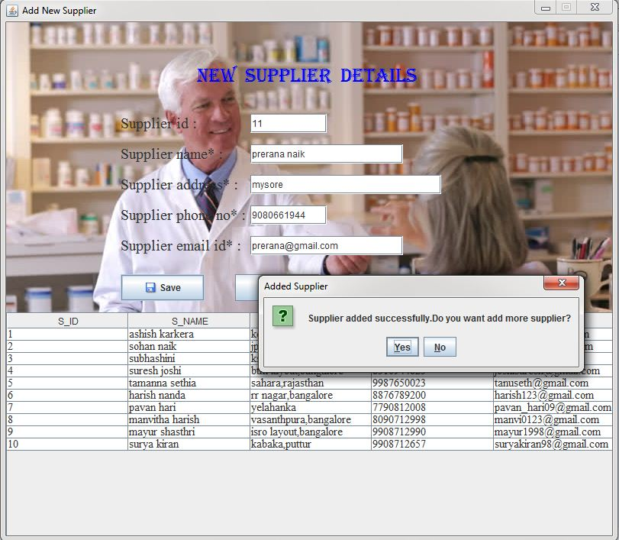
3. ADD NEW SUPPLIER

Slide 19
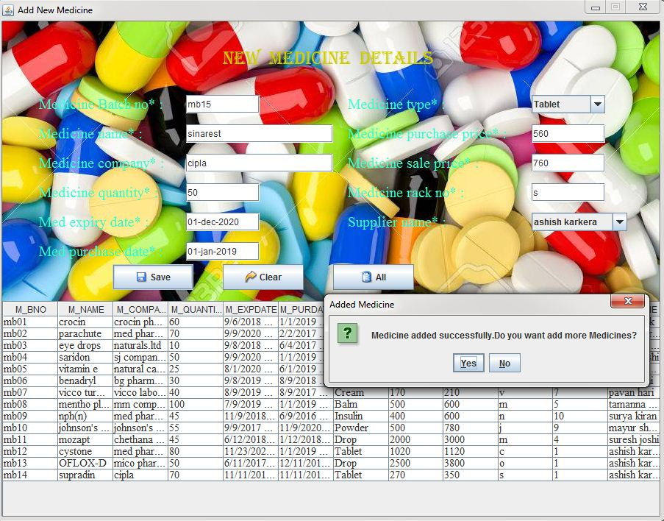
4. ADD NEW MEDICINE

Slide 20
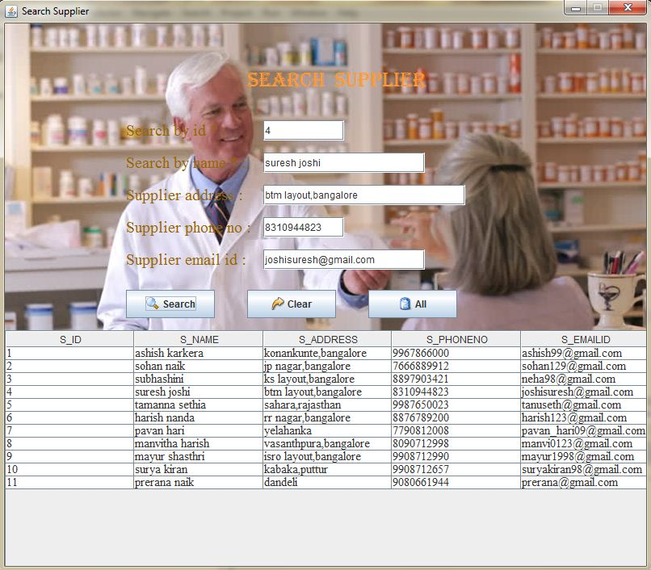
5. SEARCH SUPPLIER

Slide 21
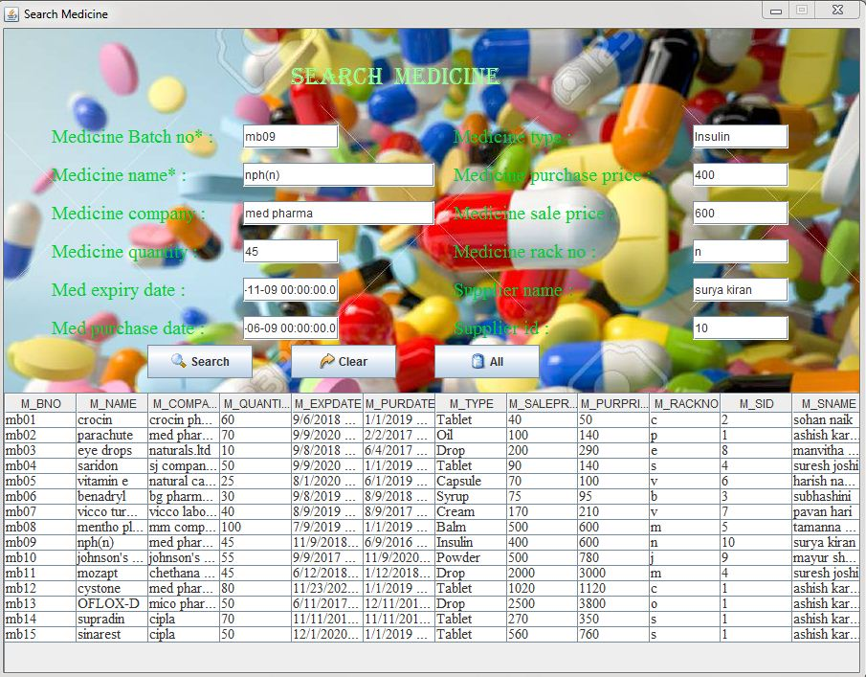
6. SEARCH MEDICINE

Slide 22
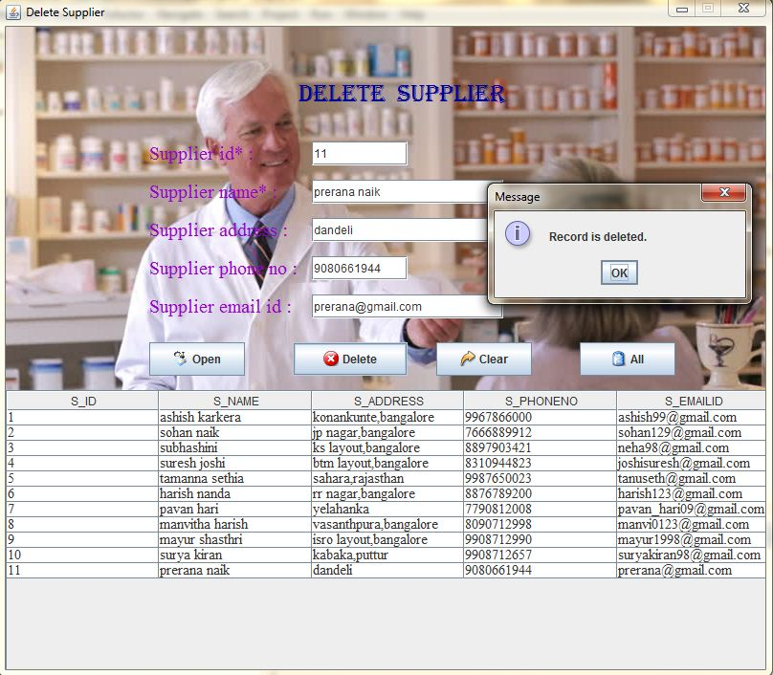
7. DELETE SUPPLIER

Slide 23
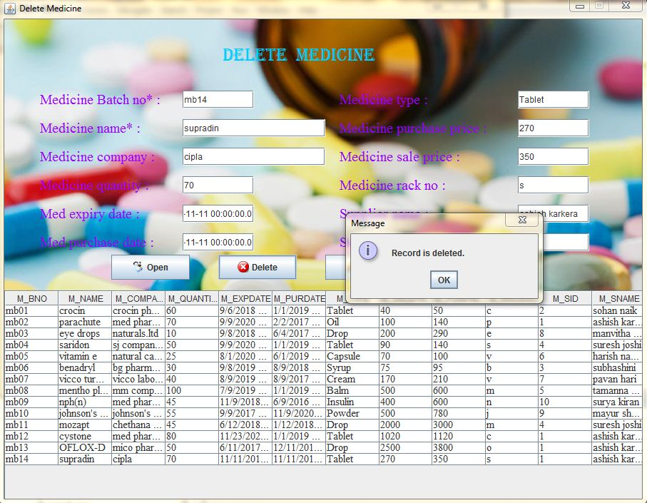
8. DELETE MEDICINE

Slide 24
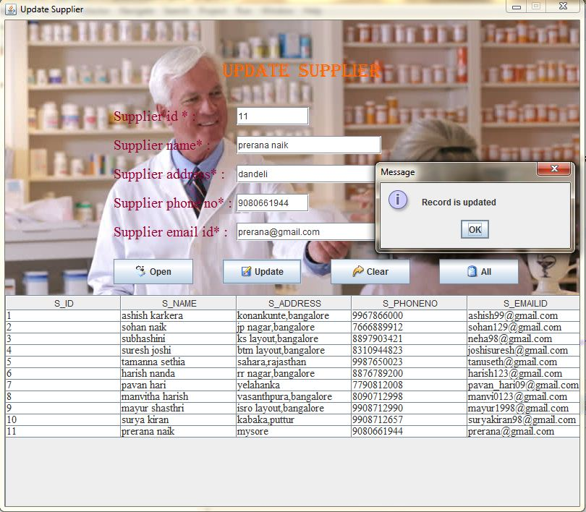
9. UPDATE SUPPLIER

Slide 25
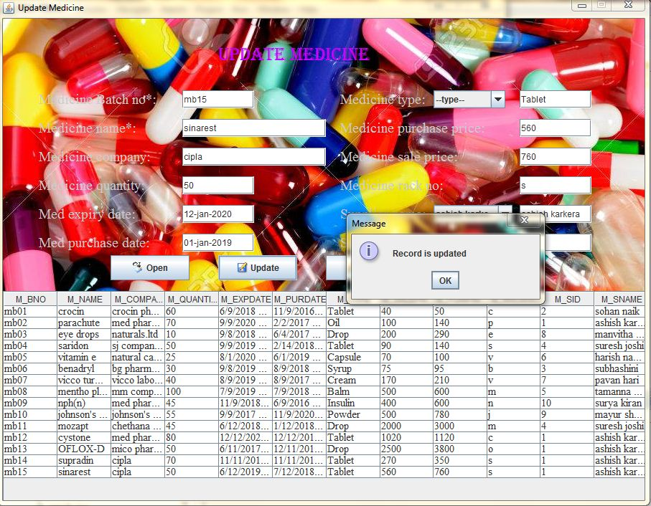
10. UPDATE MEDICINE

Slide 26
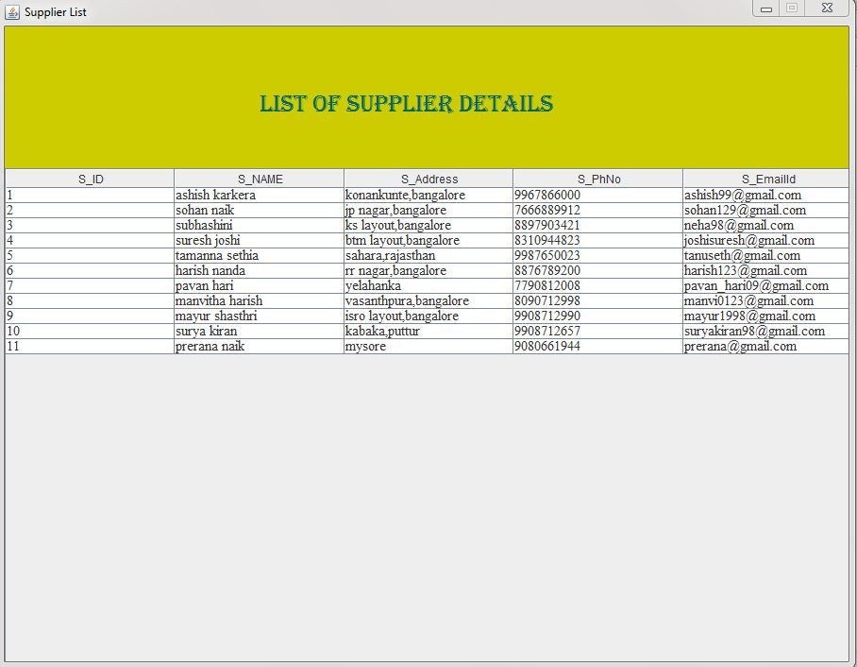
11. LIST OF SUPPLIER DETAILS

Slide 27
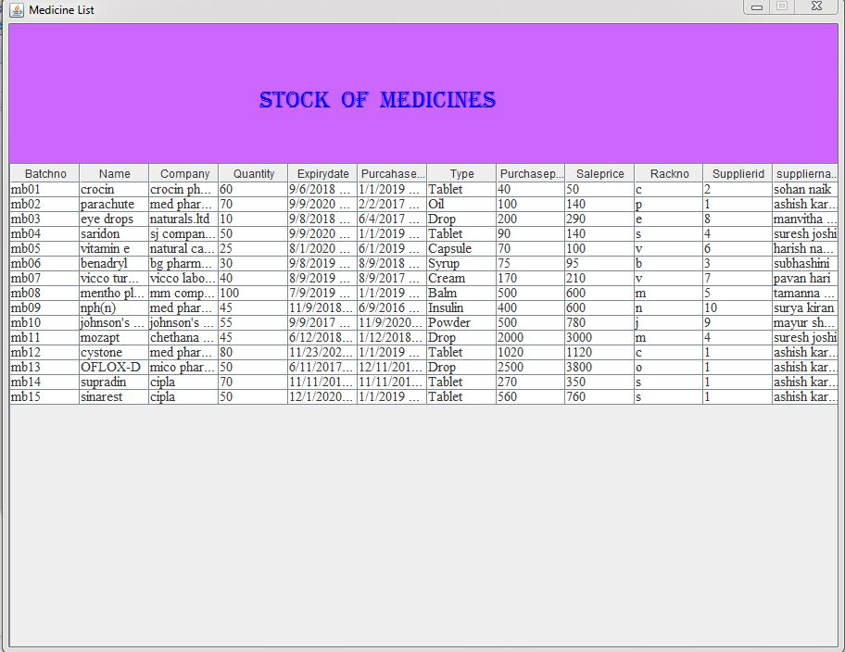
12. LIST OF MEDICINE DETAILS

Slide 28
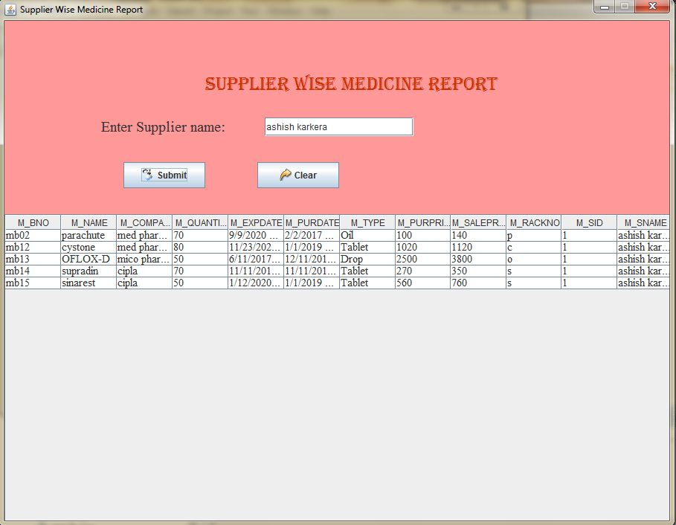
13. SUPPLIER WISE MEDICINE REPORT

Slide 29
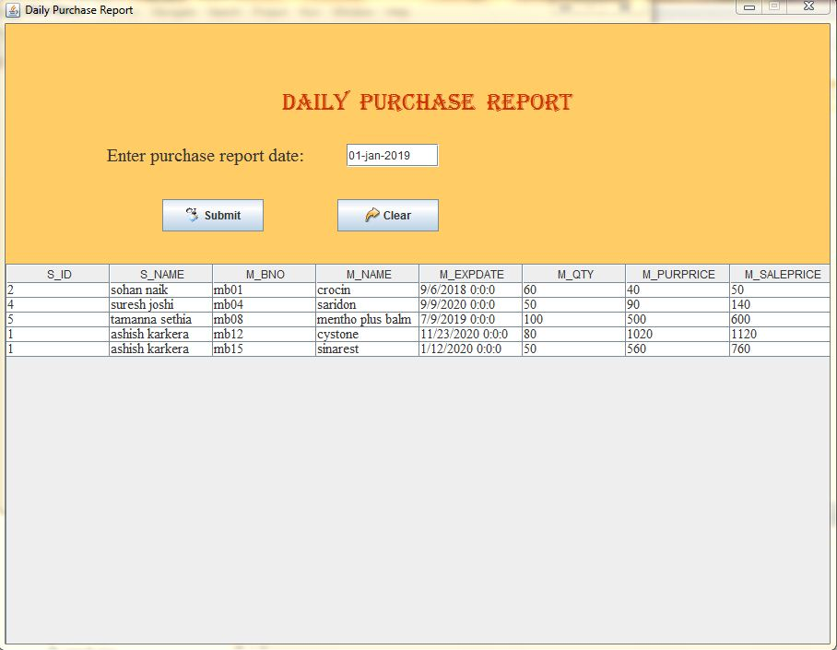
14. DAILY PURCHASE REPORT

Slide 30
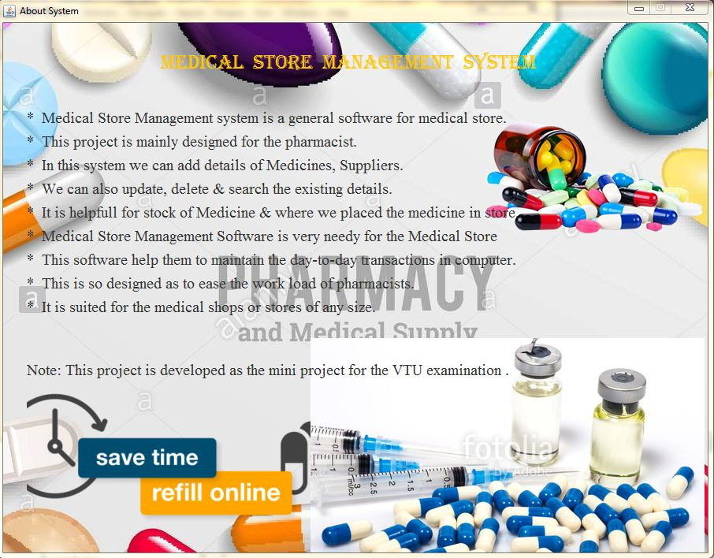
15. ABOUT

